Slide 1


Real Estate Portfolio TooL Minimum Viable Product Nick Baronti April 2022

Slide 2

Project Overview & Objectives
WHAT IS THE REAL ESTATE PORTFOLIO TOOL?
An application prototype (or “minimum viable product”) capable of reading, analyzing & visualizing real estate portfolio data and running portfolio calculations for selected portfolio actions and scenarios.
PROJECT GOALS | WHY DEVELOP THIS TOOL?
Create a technology-based real estate forecasting tool with the power to store client real estate data and automate calculations that support client real estate decisions. Build an end-to-end application that imports structured Excel-based data, stores data in a relational SQL database, runs portfolio calculations in Python, and visualizes & reports outputs in Streamlit. | Corporate entities are now making quicker, high-profile decisions around real estate due to the pandemic and accelerated adoption of Hybrid work. Currently there is a lack of technology to support corporate real estate organizations and professionals in making quick and effective real estate decisions. Organization are slow in speed to execute strategies due to data silos and inaccuracies and there is a lack of technology that supports automation.
1
1

Slide 3
Project Approach
Six Step Approach for Calculations & Visualizations:
Step 1: Populate Excel import template (multi-tab workbook). Step 2: Read Excel data into Python (into individual CSVs). Execute schema and query SQL scripts and export data to PostgreSQL using SQLalchemy. Step 3: PostgreSQL database houses all portfolio data in normalized form with primary and foreign key connections for all tables. Step 4: Data is queried from created Views in PostgreSQL and read back into Python. Calculations are then run on the aggregated View data. Step 5: Front-end user interface is driven in Streamlit with ability to select calculation types, portfolio details, and scenarios. Step 6: End user can export calculations into Excel report.
1. MS Excel
Import Data
3. PostgreSQL
Aggregate & Query Data
4. Python
Calculations
5. Streamlit
Front-End UI
6. MS Excel Export Report
2. Python
Read Data
2

Slide 4
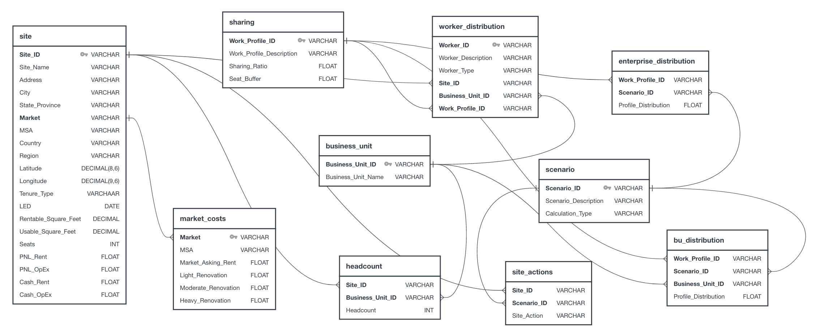
Relational Database Diagram (PostgreSQL)
3

Slide 5
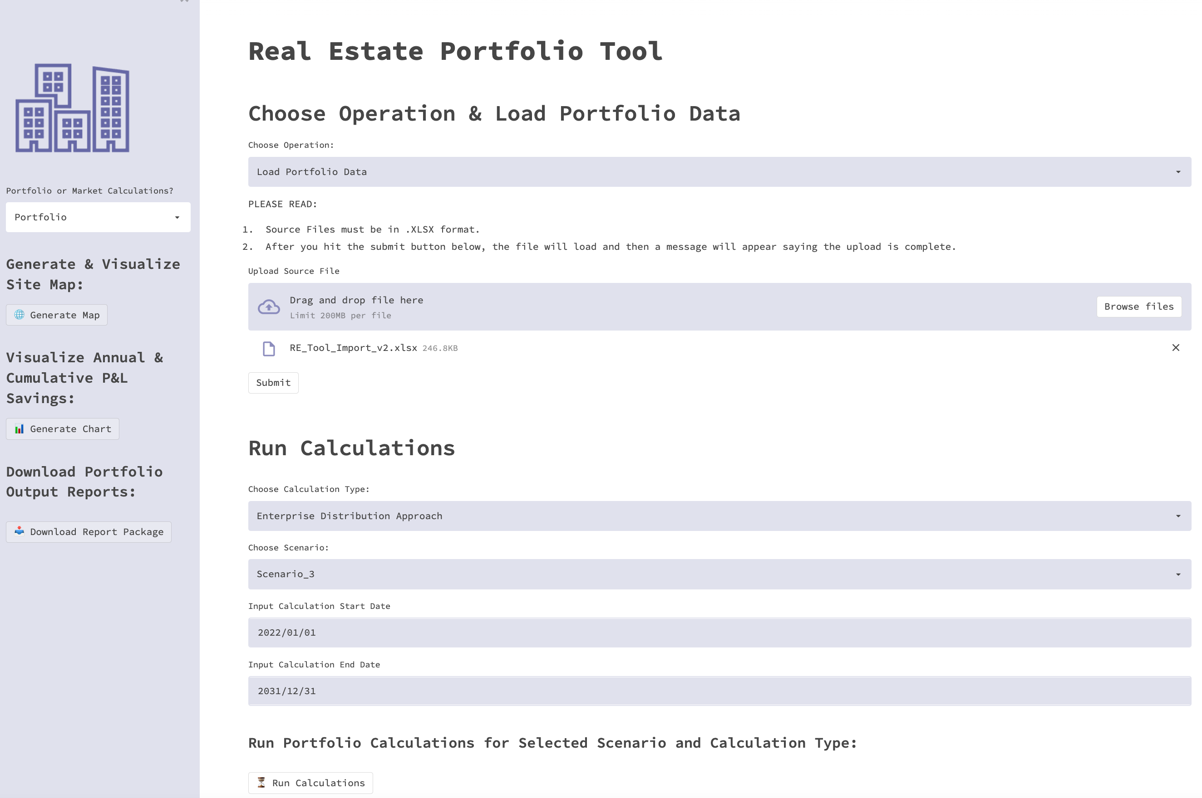
Key Outcomes – Streamlit Application
Streamlit User Interface
Upload Excel data using file browser. Click submit to read Excel data and query the data to PostgreSQL. Select either Portfolio or Market-level calculations in the left side bar. If Market-level is selected, an additional drop down will display to select a market based on the imported data. Prior to running calculations, select calculation type to perform, scenario, and input calculation start and end dates Run calculation and download reports
4

Slide 6
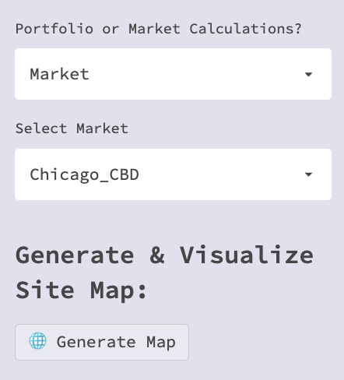
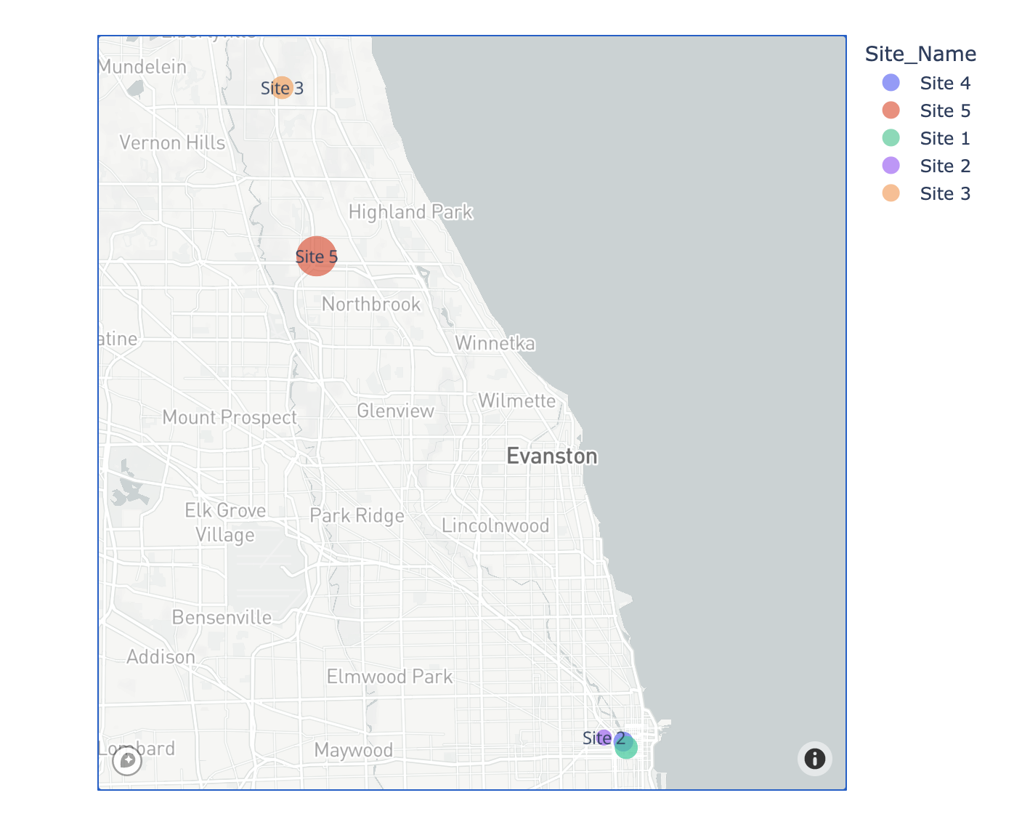
Output Analytics (Portfolio Map)
Select Market or Portfolio:
Current Portfolio Map (Based on Selection):
5

Slide 7
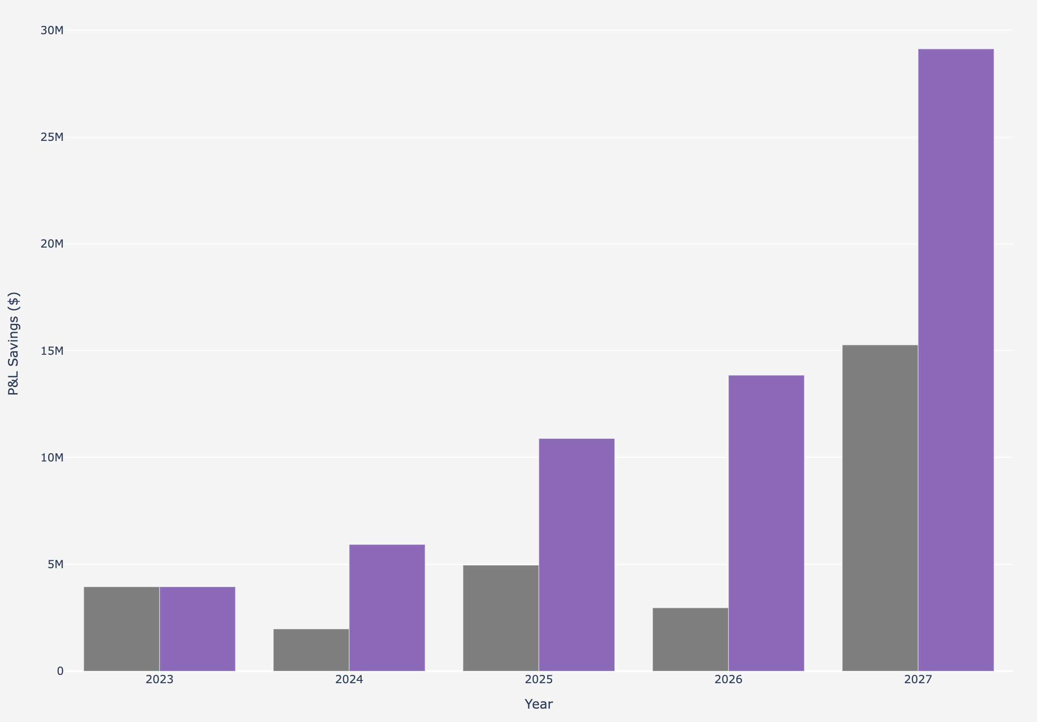
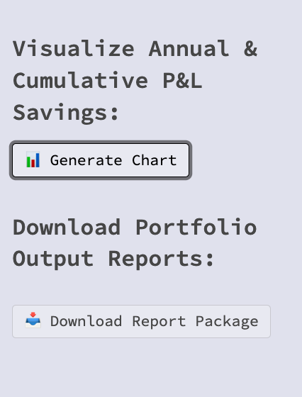

Output Analytics (Annual P&L Savings)
Annual & Cumulative Portfolio P&L Savings
Generate Visuals & Reports:
6

Slide 8
Next Steps (Beyond this Bootcamp)
Continue to develop Python script adding detailed calculations & functions for current portfolio analytics, site-level actions, and projected cash & P&L financials
Re-direct scenario calculation data back to SQL database for storage & reporting.
Build-out additional visualization and reporting capabilities.
Develop front-end user interface outside of Streamlit (i.e., Tableau, Power BI, Other Platforms).
Other portfolio tracking capabilities (i.e., project execution, actual vs. forecasts, supply vs. demand forecasting)
Other asset types calculations (manufacturing, data center), labor arbitrage, cloud data storage, client licensing & data management, machine learning and more…
7

